Slide 1
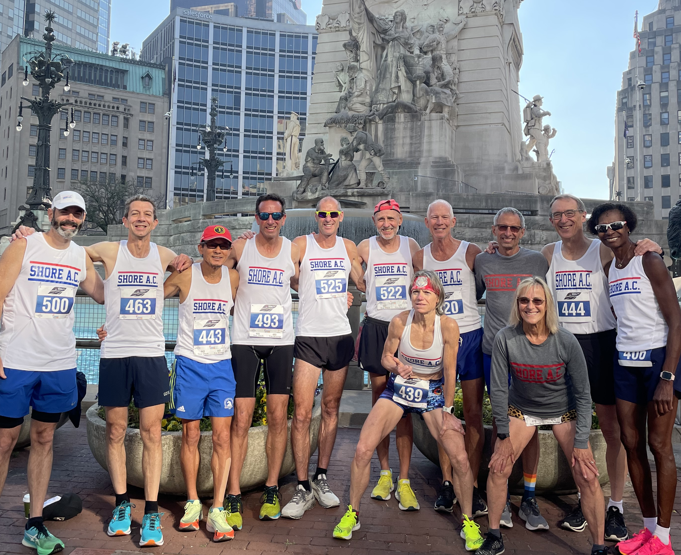
SHORE AC LONG DISTANCE RUNNING
2023 STATUS: 19 Oct. 2023

Slide 2
SHORE AC TEAM RANKINGS 2023 USATF MASTERS NATIONAL GRAND PRIX
Masters Men Winnings
Race GP
40+: 4th $100
50+: 3rd $125 $250
60+: 2nd $370 $500
70+: (nr) $150
------- -------
Totals $745 $750
Masters Women Winnings
Race GP
40+: 1st $250 $1,000
50+: 4th $225
60+: 2nd $245 $ 375
------- -------
Totals $720 $1,375
Total 2023 Masters National Team Earnings: $3,590
(Total does not include upcoming 2023 USATF Club XC Nationals in Tallahassee.)

Slide 3
SHORE AC TEAM RANKINGS 2023 USATF-NJ Club/Team Grand Prix 7 of 9 races completed
Men
Open 1st
40+ 1st
50+ 1st
60+ 1st
70+ 1st
80+ (no team)
Women
Open 1st
40+ 1st
50+ 1st
60+ 1st
70+ (no team)

Slide 4
Shore AC LDR Newcomers (1 or more USATF team races)
Men
Open Louis DiLaurenzio, Jr.
James Hoffman
Ryan Rafferty
Alex Van Driesen
40+ Andrew Yearsley
Mike Moody
50+ Eric Puma
Jeff Robinson
Kevin Sroka
60+ Mike Connolly
Miles Hersey
Gary Wiesinger
Mark Zamek
70+
Women
Open Liz Campbell
Alicia Ezekiel-pipkin
Allison McQuillen
40+ Jessica Francis
Natacha Smith
Crissa Thurman
50+ Maureen Massell
60+ Debi Brathwaite
Deborah Capko
70+

Slide 5
Shore AC LDR Team Plan for USATF Club XC Nat’s (Tallahassee)
Men
Headcount
Open A 7
40+ --- ---
50+ A 7
60+ A & B 10
70+ A 3
Women
Headcount
Open A 7
40+ A 3
50+ A 4
60+ A & B 8
70+ --- ---
Projected headcounts: Open: 14 Masters: 35

